Slide 1


Clinical and genetic predictors of breast cancer survival
Group 6

Slide 2
Background and Rationale
Breast cancer is one of the most common types of cancer affecting women worldwide
It affects women at any age after puberty but with increasing rates in later life
Rationale:
To find the best way to detect and treat breast cancer, in order to improve the quality of life of breast cancer patients
Understanding the latest research on breast cancer can help to:
Better communicate with the doctors
Play a more active role in women’s treatment decisions
Be more aware of the possible benefits and side effects of a treatment

Slide 3
Timeline
Nearly 1.7 million breast cancer cases diagnosed
1.9 million breast cancer cases diagnosed and 600 728 deaths
2.3 million breast cancer cases diagnosed and 685 000 deaths
2015
2018
2012
2017
2020
2.4 million breast cancer cases diagnosed and 523 000 deaths
2.1 million breast cancer cases diagnosed and over 625 000 deaths

Slide 4
Aims
1.
Summarize overall survival following breast cancer diagnosis, including median survival and five-year survival probability.
2.
Which baselines clinical prognostic indicators are most important prognostic indicators, including cellularity and tumor size?
3.
3.1. Is type of treatment associated with breast cancer survival?
3.2. Are these associations likely to be causal or confounded by other prognostic characteristics influencing treatment type?

Slide 5

Defining the Dataset
Target Population: Breast cancer patients between the ages 21-80
Dataset used: METABRIC (Molecular Taxonomy of Breast Cancer International Consortium)
Aims | Exposure Variable | Outcome Variable | Inclusion Criteria | Exclusion criteria | Statistical tests
1. Summarize overall survival following breast cancer diagnosis, including median survival and five-year survival probability. |  | Vital status Survival months | Have breast cancer Female Individuals diagnosed between the ages 21-80 | Individuals diagnosed over the age of 80 Individuals aged below 21 | Kaplan- Meier plot
2. Which baselines clinical prognostic indicators are most important prognostic indicators, including cellularity, tumor size and grade. | Cellularity Tumor size |  |  |  | Cox regression (chi-squared test, Schoenfeld Individual Test)
3.1. Is type of treatment associated with breast cancer survival? | Chemotherapy Hormone therapy Radio therapy |  |  |  | Multiple cox regression
3.2. Are these associations likely to be causal or confounded by other prognostic characteristics influencing treatment type? | Chemotherapy Hormone therapy Radio therapy Cellularity Tumor size
Notes:
The METABRIC is a Canada-UK project that aims to classify breast tumors into further subcategories, based on molecular signatures that will help determine the optimal course of treatment. The study population consists of clinical data and tissue samples from 2509 breast cancer patients across nine cohorts. For this project, a dataset was extracted consisting of clinical, treatment, and molecular signature for 1980 patients.

Slide 6
Data Processing
Checked for duplicates
Removed the observations where the individual was diagnosed over the age of 80
Releveled the vital status variable, assigning 0 to those who don't die of breast cancer, and 1 to those that die of breast cancer
Rows containing missing values for the exposure and outcome variables were removed, this was 84 rows

Slide 7
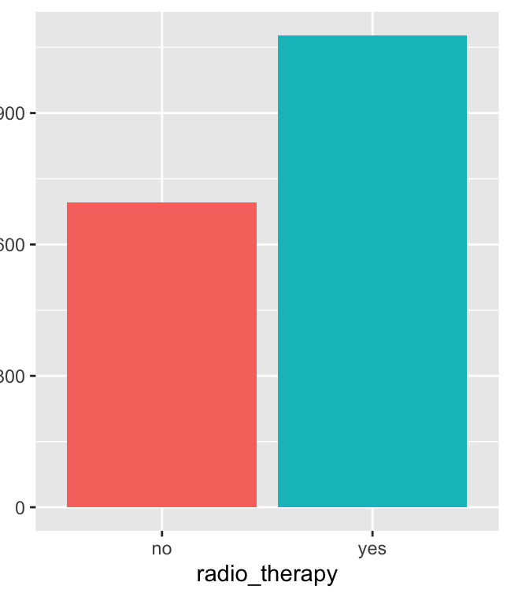
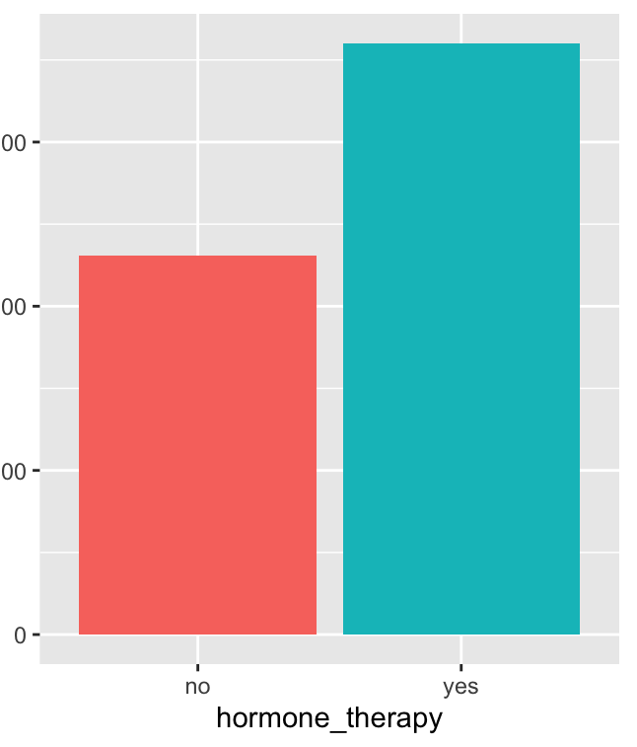
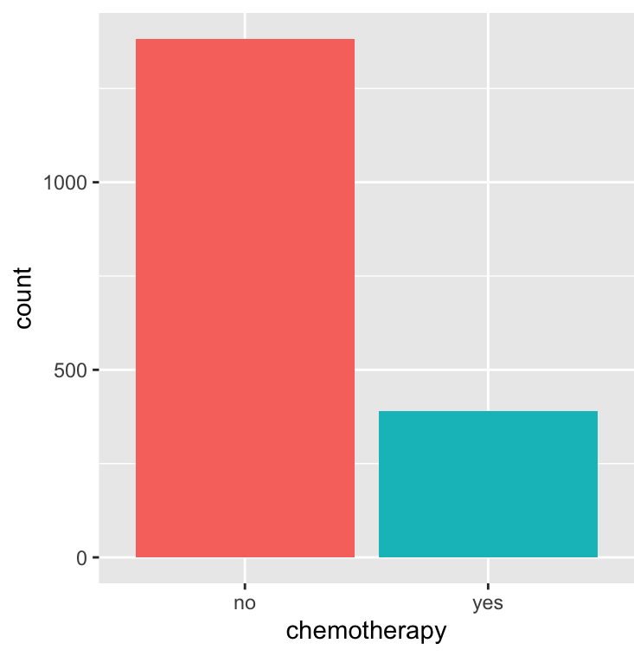
Frequency of each treatment
Figure 1: The bar charts above shows the frequency of individuals receiving treatment or no treatment (Radiotherapy, Hormone therapy and Chemotherapy respectively).
Notes:
Out of 1774 observations
1078 receive radio therapy, 696 do not
391 Receive chemotherapy 1383 do not
1081 receive hormone therapy, 693 d not.

Slide 8
EDA
 | Hormone Therapy
Radio Therapy |  | No | Yes
 | No | 304 | 392
 | Yes | 389 | 689
 | Chemotherapy
Radio Therapy |  | No | Yes
 | No | 623 | 73
 | Yes | 760 | 318
 | Chemotherapy
Hormone Therapy |  | No | Yes
 | No | 482 | 211
 | Yes | 901 | 180
Notes:
The use of one therapy is linked to other therapies received
For example
If you're not receiving radio therapy, you're unlikely to be receiving chemotherapy
If you're receiving hormone therapy, you're unlikely to be receiving chemotherapy

Slide 9
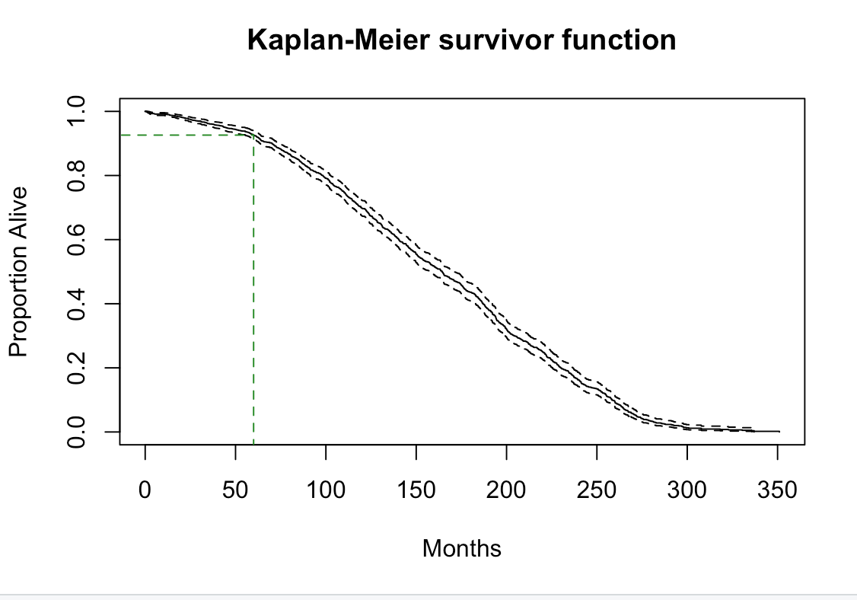
1. Summarize overall survival following breast cancer diagnosis, including median survival and five-year survival probability
n | events | median | 0.95LCL | 0.95UCL
1774 | 1190 | 164 | 158 | 171
Median survival is 164 months.
95% CL (158, 171)
Five-year survival probability is 0.926
time | n.risk | n.event | survival | Std.err | Lower 95% CI | Upper 95% CI
60 | 1350 | 119 | 0.926 | 0.007 | 0.914 | 0.939
Notes:
We did a Kaplan-Meier survival estimate here. And the table

Slide 10
2. Which baselines clinical prognostic indicators are most important prognostic indicators, including cellularity and tumor size.
Let’s check the distribution for tumor stage:
Tumor stage is linked to the tumor size and there are too many missing values, so we choose not to include tumor stage.
0 | 1 | 2 | 3 | 4 | Missing value
8 | 459 | 741 | 102 | 9 | 455

Slide 11
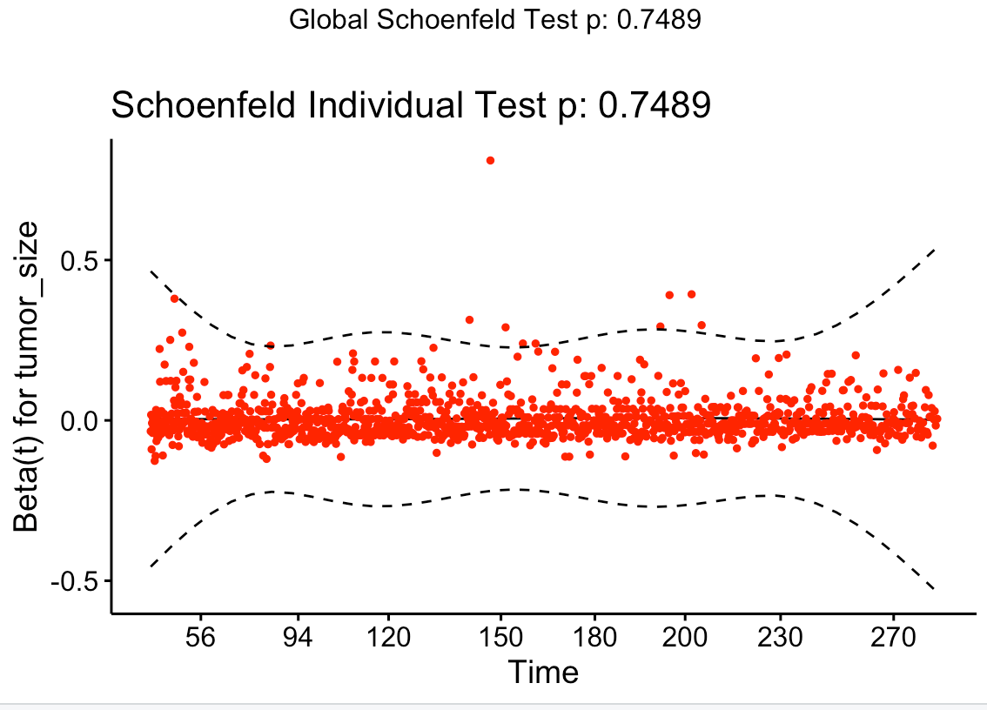
Tumor size
H0: Tumor size has no influence on survival
Proportional hazards assumption:
-chi-squared test:
 | Exp(coef) | 95% CI | P-value
Tumor Size | 1.005 | (1.001, 1.009) | 0.018
 | chisq | df | P-value
Tumor size | 0.102 | 1 | 0.75
GLOBAL | 0.102 | 1 | 0.75
Notes:
Exp(coef) represents hazard ratio.
For each 1 unit greater in tumor size, the mortality hazard of breast cancer increases by 0.5% , CI..., p-value..., conclude...
And we test the proportional hazards assumption for the cox regression model:
We calculate the Schoenfeld residuals as a function of time for the beta coefficient, here we have the hypothesis that a non-zero linear trend to the residuals against time, which indicated a violation of the proportional hazards assumption. And we also did a graphical diagnostic to produce the graph of the Schoenfeld residuals against time.
Here the p-value is 0.75 which is not significant, thus we can assume the proportional hazards.

Slide 12
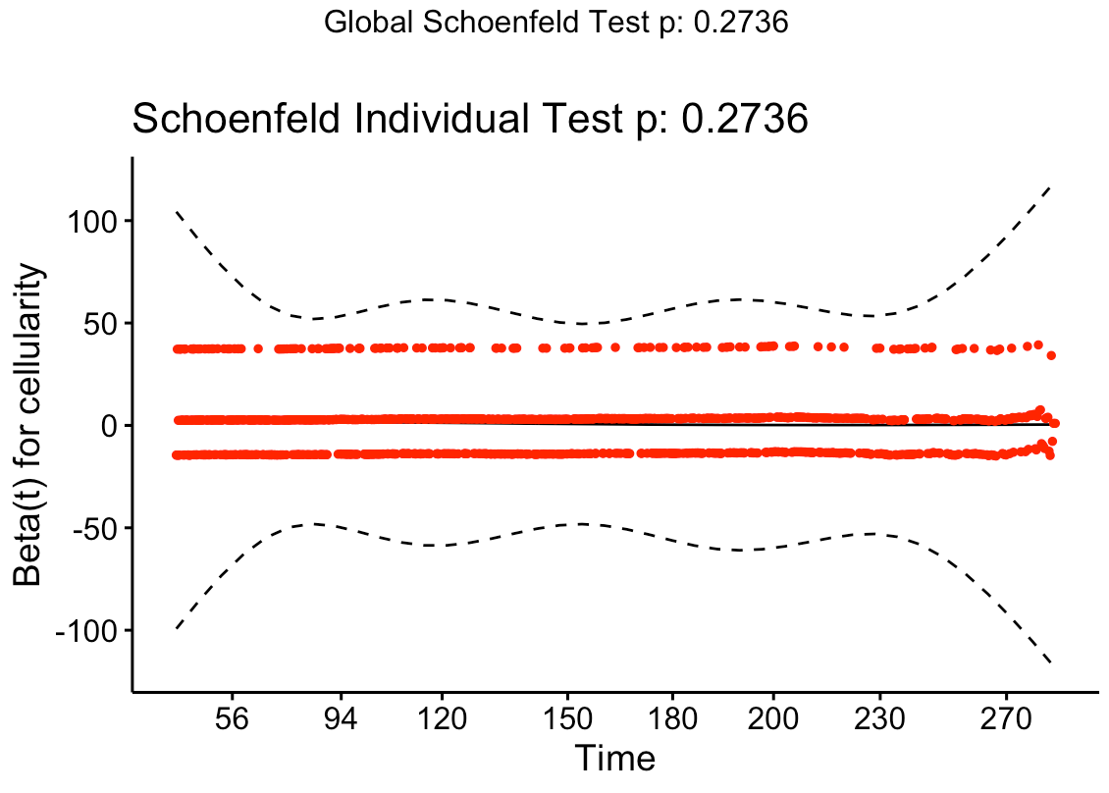
Cellularity
H0: Cellularity has no influence on survival
3 groups: low, moderate and high (reference group)
Proportional hazards assumption:
-chi-squared test:
 | Exp(coef) | 95% CI | P-value
low | 1.15 | (0.96, 1.38) | 0.134
moderate | 0.93 | (0.83, 1.06) | 0.279
 | chisq | df | P-value
grade | 2.59 | 2 | 0.27
GLOBAL | 2.59 | 2 | 0.27
Notes:
Exp(coef) represents hazard ratio.
Here the p-value is 0.27 which is not significant, thus we can assume the proportional hazards as well.

Slide 13
3.1 Is type of treatment associated with breast cancer survival?
H0: Breast cancer treatment is not associated with breast cancer survival
H1: Breast cancer treatment is associated with breast cancer survival
 | Exp(coef) | 95% CI | P-value
Chemotherapy (yes) | 1.28 | (1.09, 1.50) | 0.002
Hormone Therapy (yes) | 1.64 | (1.45, 1.86) | < 0.001
Radio Therapy (yes) | 0.96 | (0.85, 1.08) | 0.524
Notes:
Why no breast surgery

Slide 14
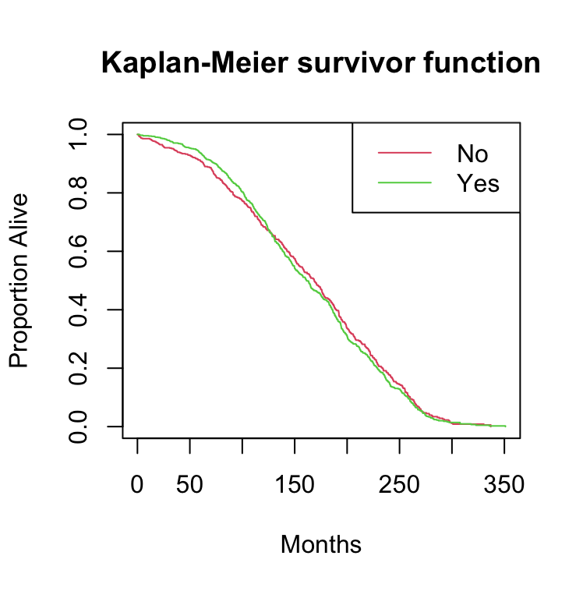
3.1 Is type of treatment associated with breast cancer survival?
 | Exp(coef) | 95% CI | P-value
Chemotherapy (yes) | 1.29 | (1.10, 1,51) | 0.002
Hormone Therapy (yes) | 1.64 | (1.46, 1.86) | < 0.001
Radio Therapy (yes) | 0.81 | (0.67, 0.98) | 0.033
Radio Therapy (yes) and over 120 months | 1.31 | (0.76, 1.03) | 0.029
Notes:
Testing whether hazard ratio = 1

Slide 15
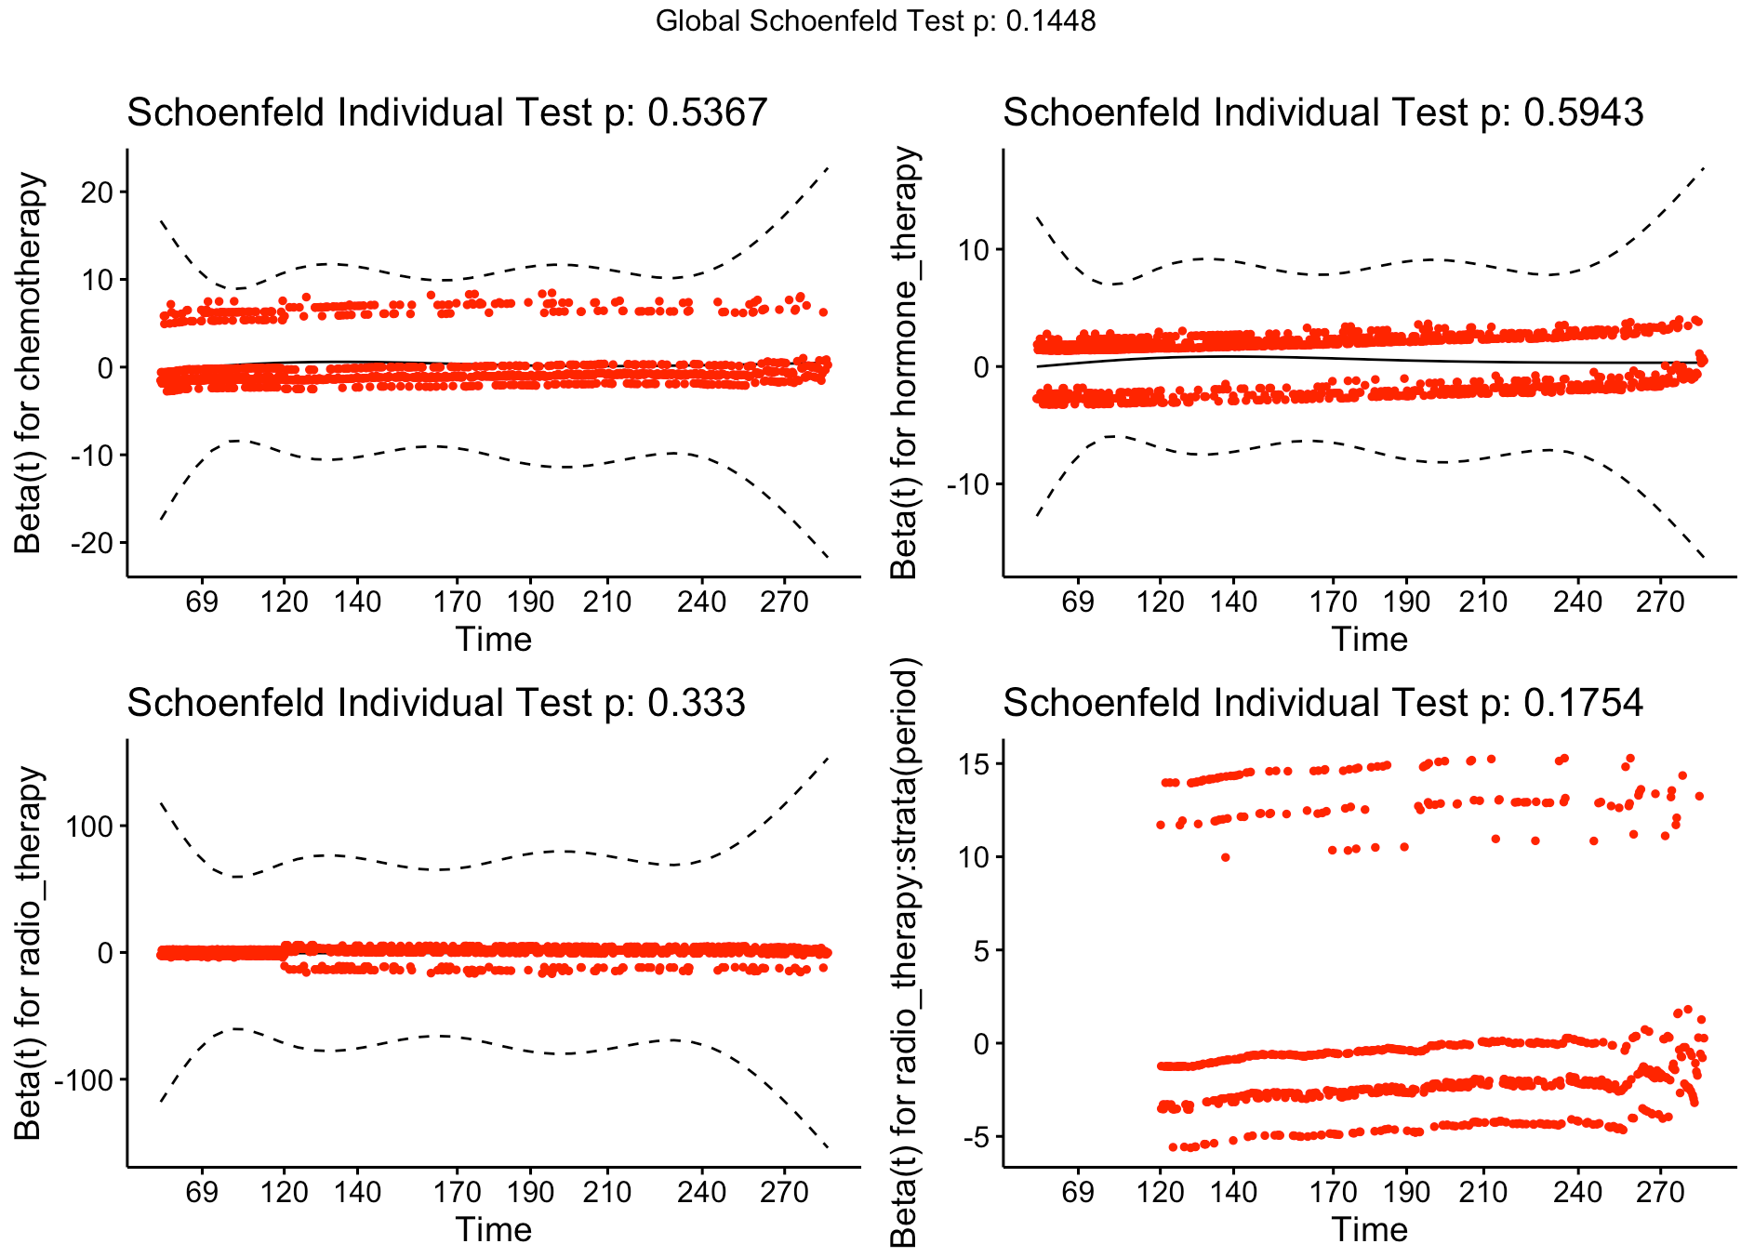
3.1 Is type of treatment associated with breast cancer survival?
Proportional hazards assumption:
-chi-squared test:
 | chisq | df | pvalue
Chemotherapy | 0.38 | 1 | 0.54
Hormone Therapy | 0.28 | 1 | 0.59
Radio Therapy | 0.94 | 1 | 0.33
Radio Therapy and over 120 months | 1.84 | 1 | 0.18
GLOBAL | 6.84 | 4 | 0.14

Slide 16
3.1 Is type of treatment associated with breast cancer survival?
Sensitivity test:
Attempted adding in tumor size into the final model
​ | Final Model |  | Model with Tumor size
 | Exp(estimate) | P-value | Exp(estimate) | P-value
Chemotherapy​ | 1.29 | 0.002 | 1.26 | 0.005
Hormone Therapy​ | 1.64 | < 0.001 | 1.63 | < 0.001
Radio Therapy​ | 0.81 | 0.033 | 0.81 | 0.033
Radio Therapy and over 120 months​ | 1.31 | 0.029 | 1.31 | 0.028
Tumor Size | - | - | 1.00 | 0.34
Notes:
Since the model has barely changed with the addition of a significant predictor, it implies that the results of our model are robust.

Slide 17
3.2. Are these associations likely to be causal or confounded by other prognostic characteristics influencing treatment type?
Tumor Size
Aim 2 and
Literature
Literature
Treatment
Survival
Possible confounder
Notes:
There is no formal test for causality
Tumor size proceeds treatment and survival

Slide 18
3.2. Are these associations likely to be causal or confounded by other prognostic characteristics influencing treatment type?
Cellularity
Aim 2
Treatment
Survival
Not a confounder
Notes:
Cellularity is not associated with survival, thus cannot be a confounder

Slide 19
Conclusions
1. The baseline clinical prognostic indicator tumor size has an influence on the survival of breast cancer whereas cellularity doesn't have an influence on the survival of breast cancer.
2. Chemotherapy, Hormone therapy and Radio therapy are associated with breast cancer survival after we fit a time splitting.
3. Tumor size proceeds treatment and survival, which could be considered as a confounder.
4. Cellularity is not associated with survival, thus cannot be a confounder.

Slide 20
Linking back to Hypothesis
Aim 2: Which baselines clinical prognostic indicators are most important prognostic indicators, including tumor_size and cellularity?
H0: Tumor size has no influence on survival
H1: Tumor size has influence on survival
H0: Cellularity has no influence on survival
H1: Cellularity has no influence on survival

Slide 21
Linking back to Hypothesis (Continued)
Aim 3.1 Is type of treatment associated with breast cancer survival?
H0: Breast cancer treatment is not associated with breast cancer survival
H1: Breast cancer treatment is not associated with breast cancer survival
Aim 3.2. Are these associations likely to be causal or confounded by other prognostic characteristics influencing treatment type?
Tumor size Possibly Confounds treatment type and survival
Notes:
t
Tumor size possibly confounds treatment type and surival.

Slide 22
Future Implications
Public health education on awareness of signs and symptoms.
Emphasis on the importance of early detection and treatment through consulting with medical practitioners.
Combination of public and health worker education.
Next Generation Sequencing in the implementation of cancer predictors and prognosticators.
Improves the prediction of survival in breast cancer and better diagnostic services.

Slide 23
Limitations
Small sample size: Increased prevalence of breast cancer worldwide. (2.1 million cases according to World Health Organization)
Findings can only be generalizable to women. Not very accurate as breast cancer is also prevalent among Males.

Slide 24
References
https://jhoonline.biomedcentral.com/articles/10.1186/s13045-019-0783-9
https://bmjopen.bmj.com/content/9/10/e028461
https://www.wcrf.org/dietandcancer/breast-cancer/
https://www.thelancet.com/journals/langlo/article/PIIS2214-109X(20)30215-1/fulltext
https://www.who.int/news-room/fact-sheets/detail/breast-cancer
https://journals.plos.org/plosone/article?id=10.1371/journal.pone.0122413
https://www.ncbi.nlm.nih.gov/pmc/articles/PMC3457875/
https://pubmed.ncbi.nlm.nih.gov/29868153/
https://www.ncbi.nlm.nih.gov/pmc/articles/PMC3126011/
https://www.ncbi.nlm.nih.gov/pmc/articles/PMC6850492/

Slide 25

Any Questions?
Thank You !

Slide 26

Appendix

Slide 27
Defining the dataset
The METABRIC is a Canada-UK project that aims to classify breast tumors into further subcategories, based on molecular signatures that will help determine the optimal course of treatment. The study population consists of clinical data and tissue samples from 2509 breast cancer patients across nine cohorts. For this project, a dataset was extracted consisting of clinical, treatment, and molecular signature for 1980 patients.

Slide 28
Data Processing
cancer_dat_initial <- read.csv('/Users/yuanleili/Desktop/metabric-analytical.csv', header = T)
cancer_dat <- cancer_dat_initial %>% filter(age_diagnosis <= 80)
cancer_dat$chemotherapy <- as.factor(cancer_dat$chemotherapy)
cancer_dat$hormone_therapy <- as.factor(cancer_dat$hormone_therapy)
cancer_dat$radio_therapy <- as.factor(cancer_dat$radio_therapy)
cancer_dat$breast_surgery <- as.factor(cancer_dat$breast_surgery)
cancer_dat$surv_status <- as.factor(cancer_dat$surv_status)
cancer_dat$vital_status <- as.factor(cancer_dat$vital_status)
cancer_dat$cellularity <- as.factor(cancer_dat$cellularity)
cancer_dat$grade <- as.factor(cancer_dat$grade)
levels(cancer_dat$vital_status) <- c(1,0,0,NA)
cancer_dat$vital_status <- as.numeric(cancer_dat$vital_status)
names(cancer_dat)
dim(cancer_dat)
cancer_dat <- cancer_dat[complete.cases(cancer_dat[ , c(2,4,8,10,14,15,16)]),]
dim(cancer_dat)

Slide 29
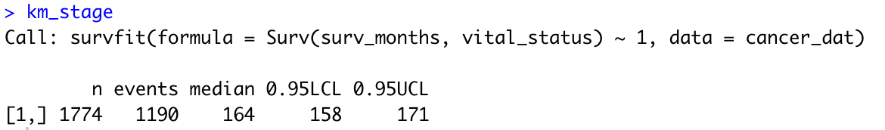
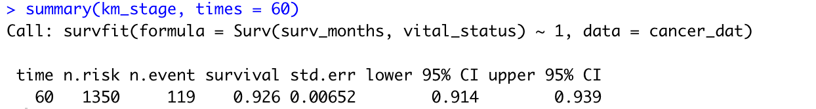
Aim 1
km_stage <- survfit(Surv(surv_months, vital_status) ~ 1, data = cancer_dat)
summary(km_stage)
km_stage
plot(km_stage, main = "Kaplan-Meier survivor function", xlab = "Months", ylab = "Proportion Alive")
lines(c(60,60), c(-0.1, 0.926),lty="dashed", col="forestgreen")
lines(c(-13,60),c(0.926,0.926),lty="dashed", col="forestgreen")
summary(km_stage, time=60)

Slide 30
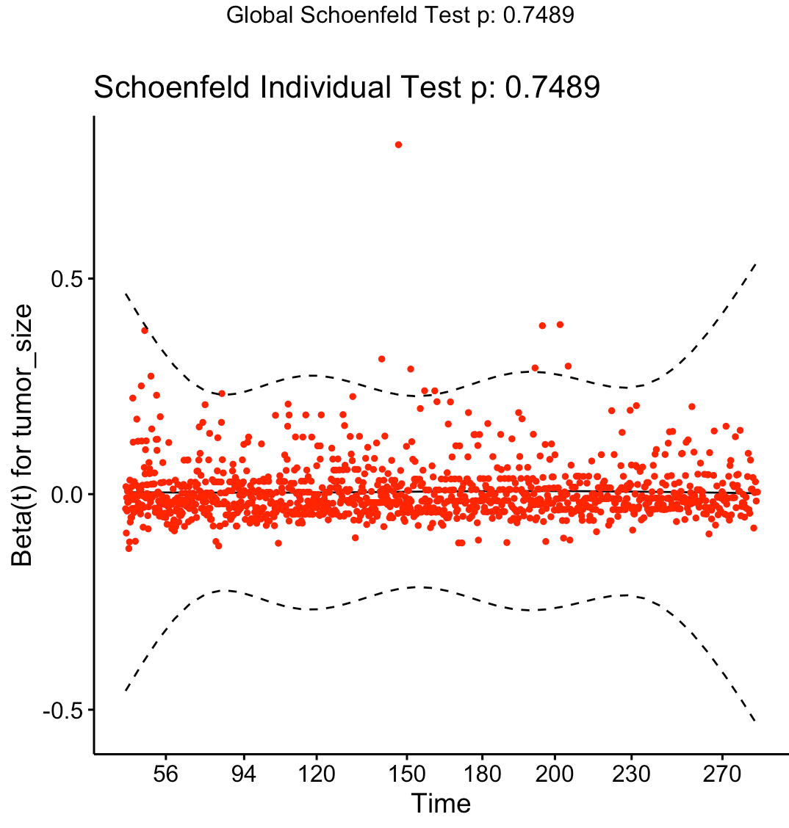
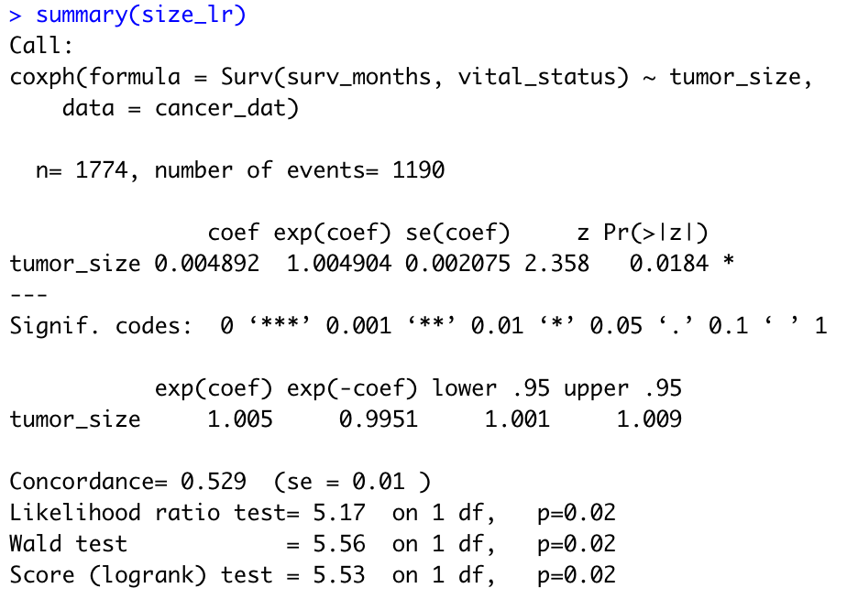
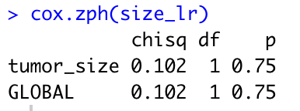
Aim 2
size_lr <- coxph(Surv(surv_months, vital_status) ~ tumor_size, data = cancer_dat)
summary(size_lr)
cox.zph(size_lr)
ggcoxzph(cox.zph(size_lr))

Slide 31
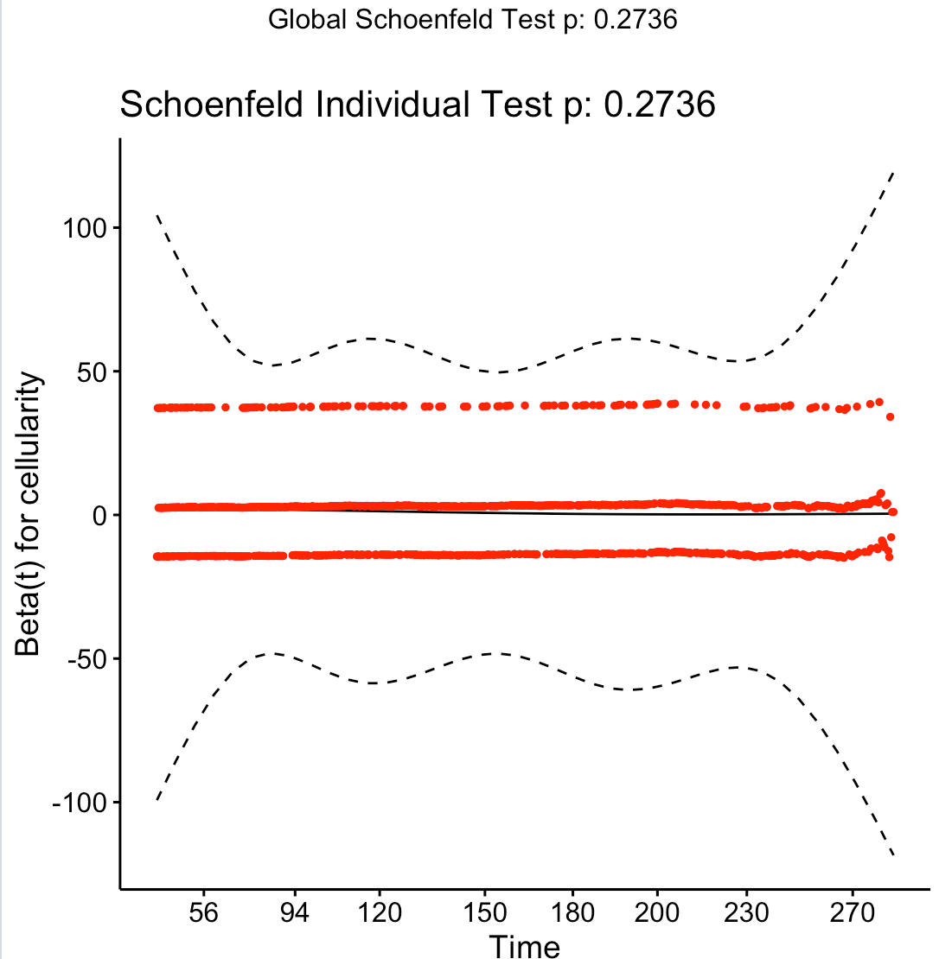
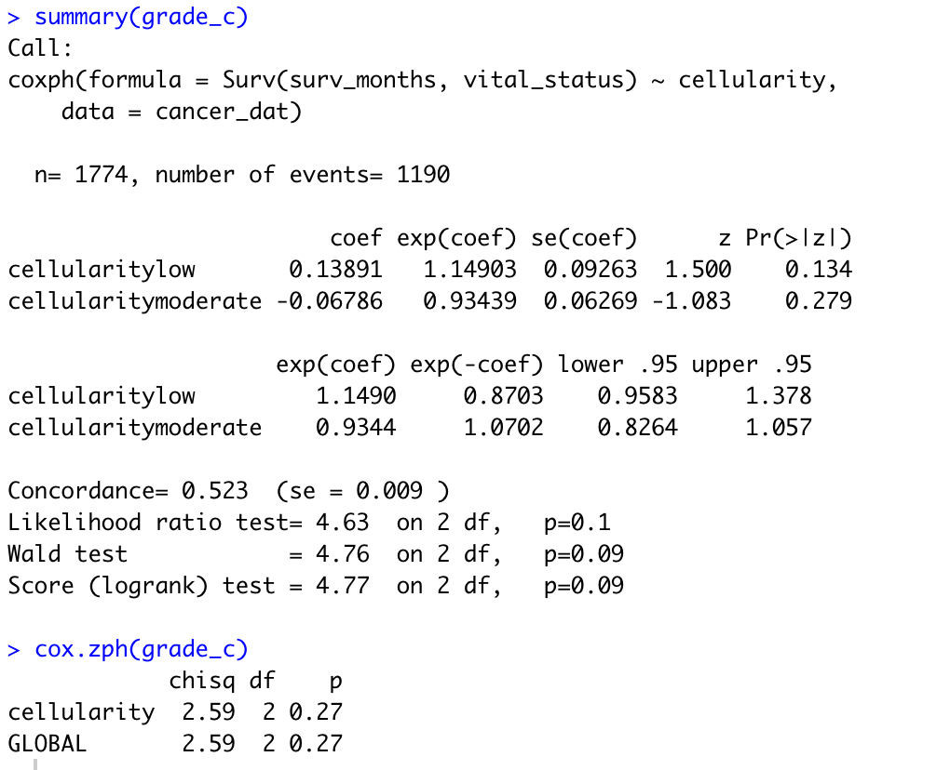
Aim 2
grade_c <- coxph(Surv(surv_months, vital_status) ~ cellularity, data = cancer_dat)
summary(grade_c)
cox.zph(grade_c)
ggcoxzph(cox.zph(grade_c))

Slide 32
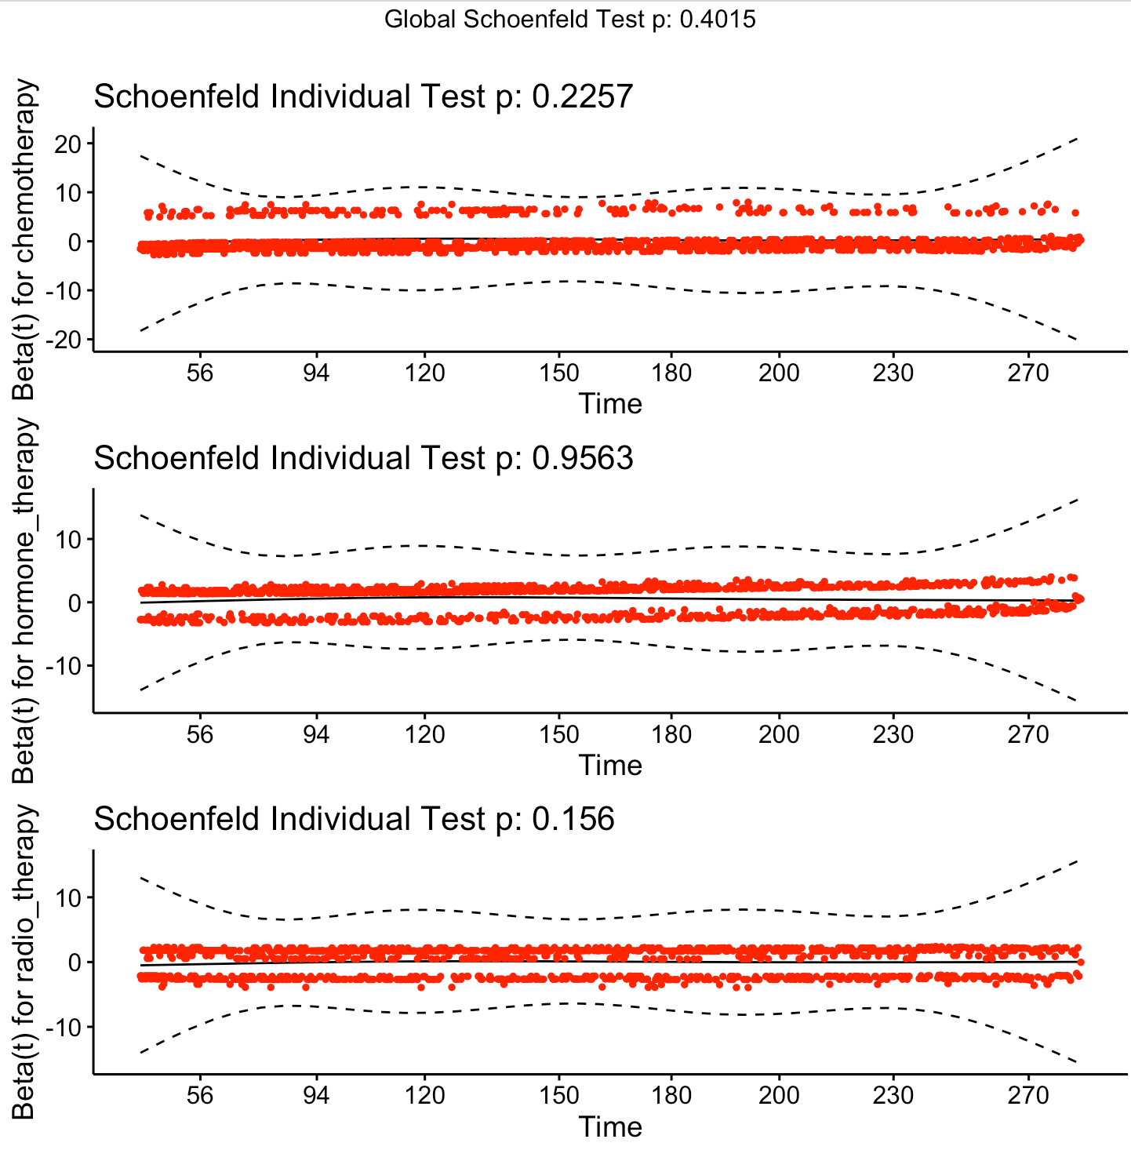
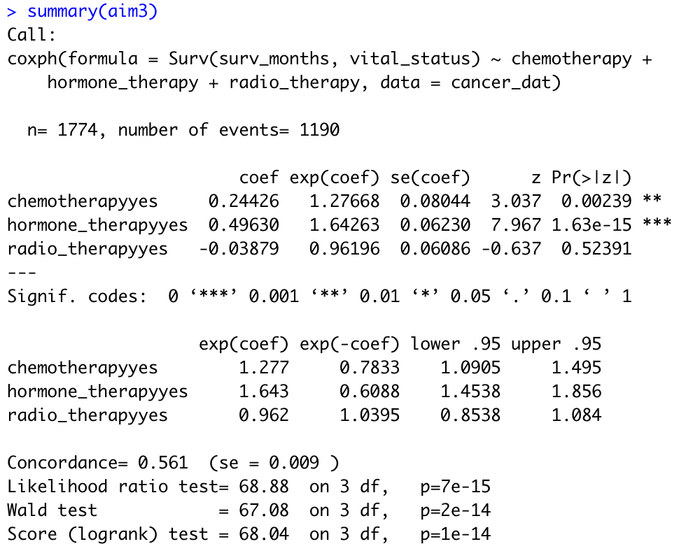
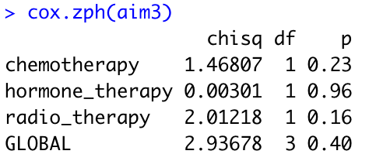
Aim 3
aim3 <- coxph(Surv(surv_months, vital_status) ~ chemotherapy + hormone_therapy + radio_therapy, data = cancer_dat)
summary(aim3)
cox.zph(aim3)
ggcoxzph(cox.zph(aim3))

Slide 33
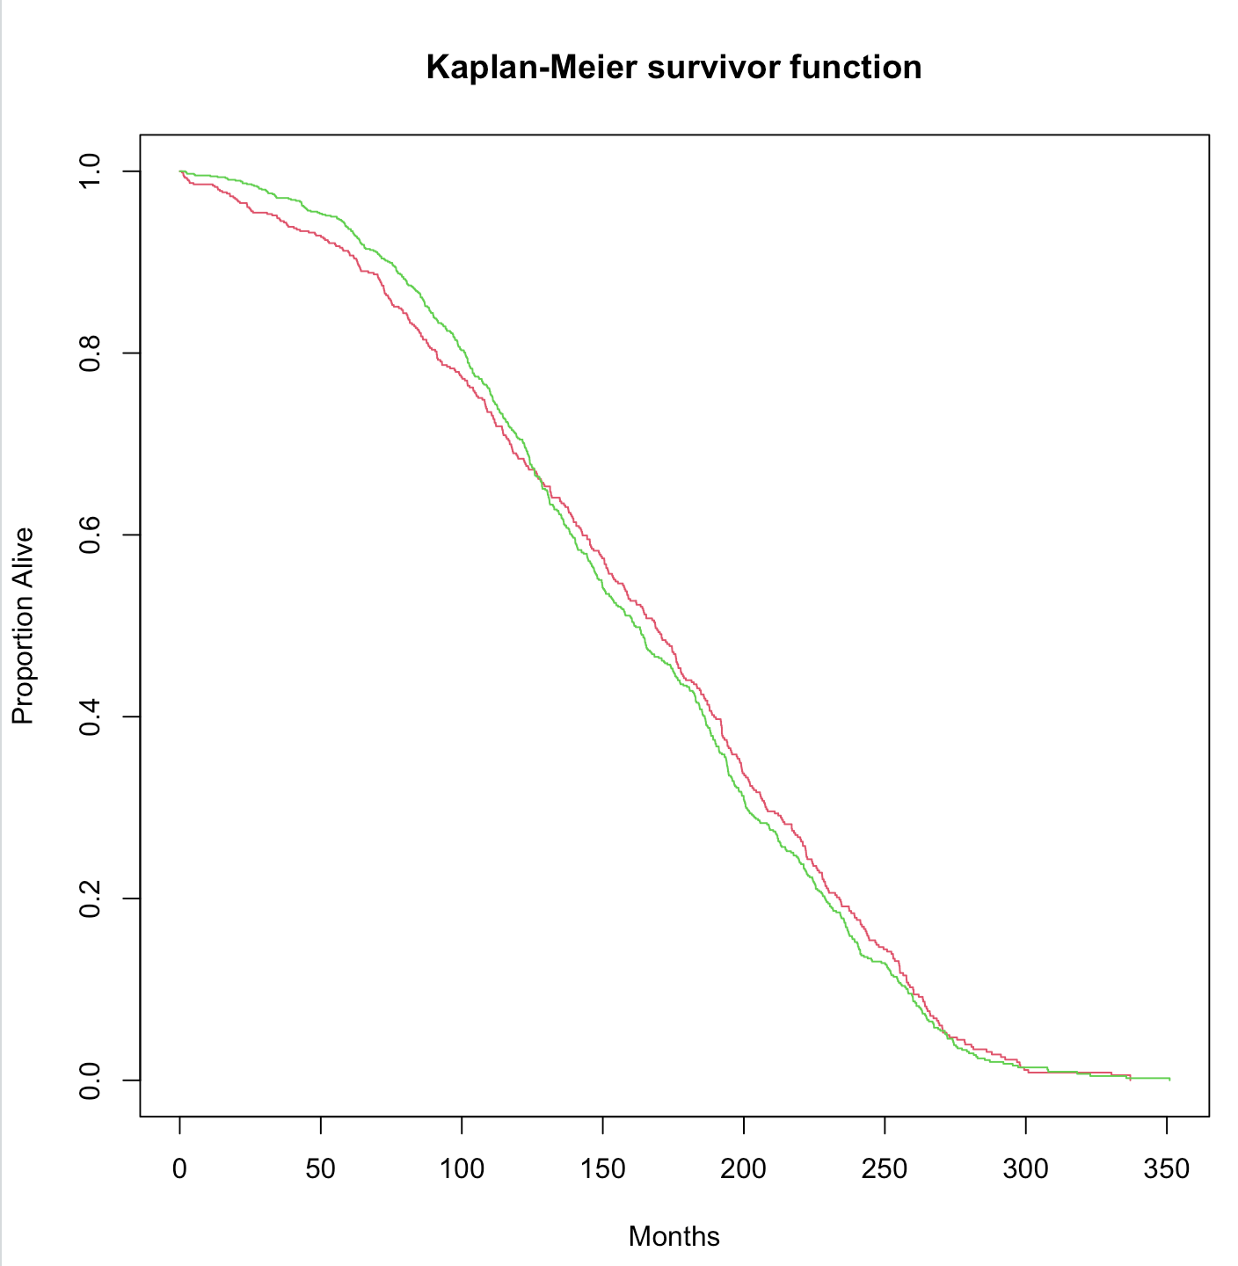
Aim 3
km_rad <- survfit(Surv(surv_months, vital_status) ~ radio_therapy, data = cancer_dat)
plot(km_rad, col = 2:3, main = "Kaplan-Meier survivor function", xlab = "Months", ylab = "Proportion Alive")

Slide 34
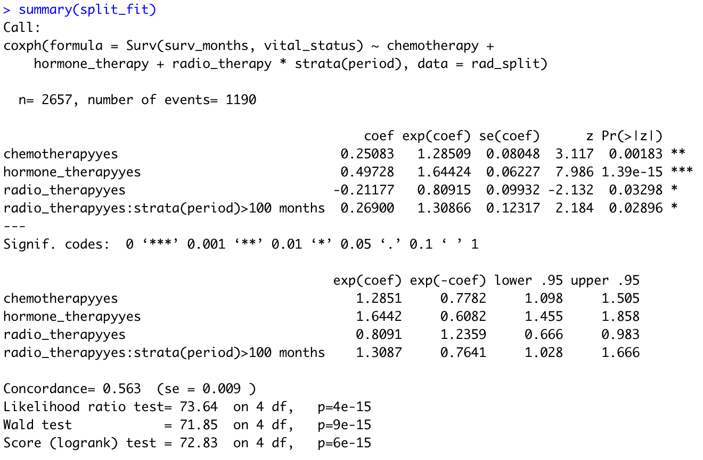
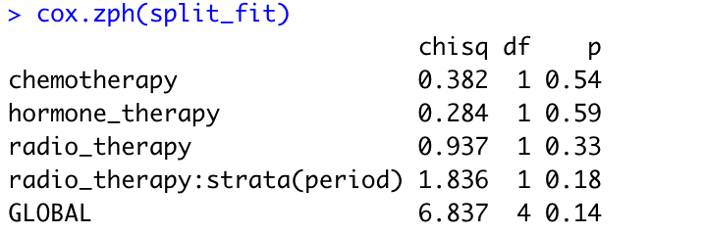
Aim 3
rad_split <- survSplit(Surv(surv_months,vital_status) ~ ., data = cancer_dat, cut = 120, episode = 'period')
rad_split$period <- factor(rad_split$period, 1:2, c('<100 months', '>100 months'))
split_fit <- coxph(Surv(surv_months, vital_status) ~ chemotherapy + hormone_therapy + radio_therapy * strata(period), data = rad_split)
summary(split_fit)
cox.zph(split_fit)
ggcoxzph(cox.zph(split_fit))

Slide 35
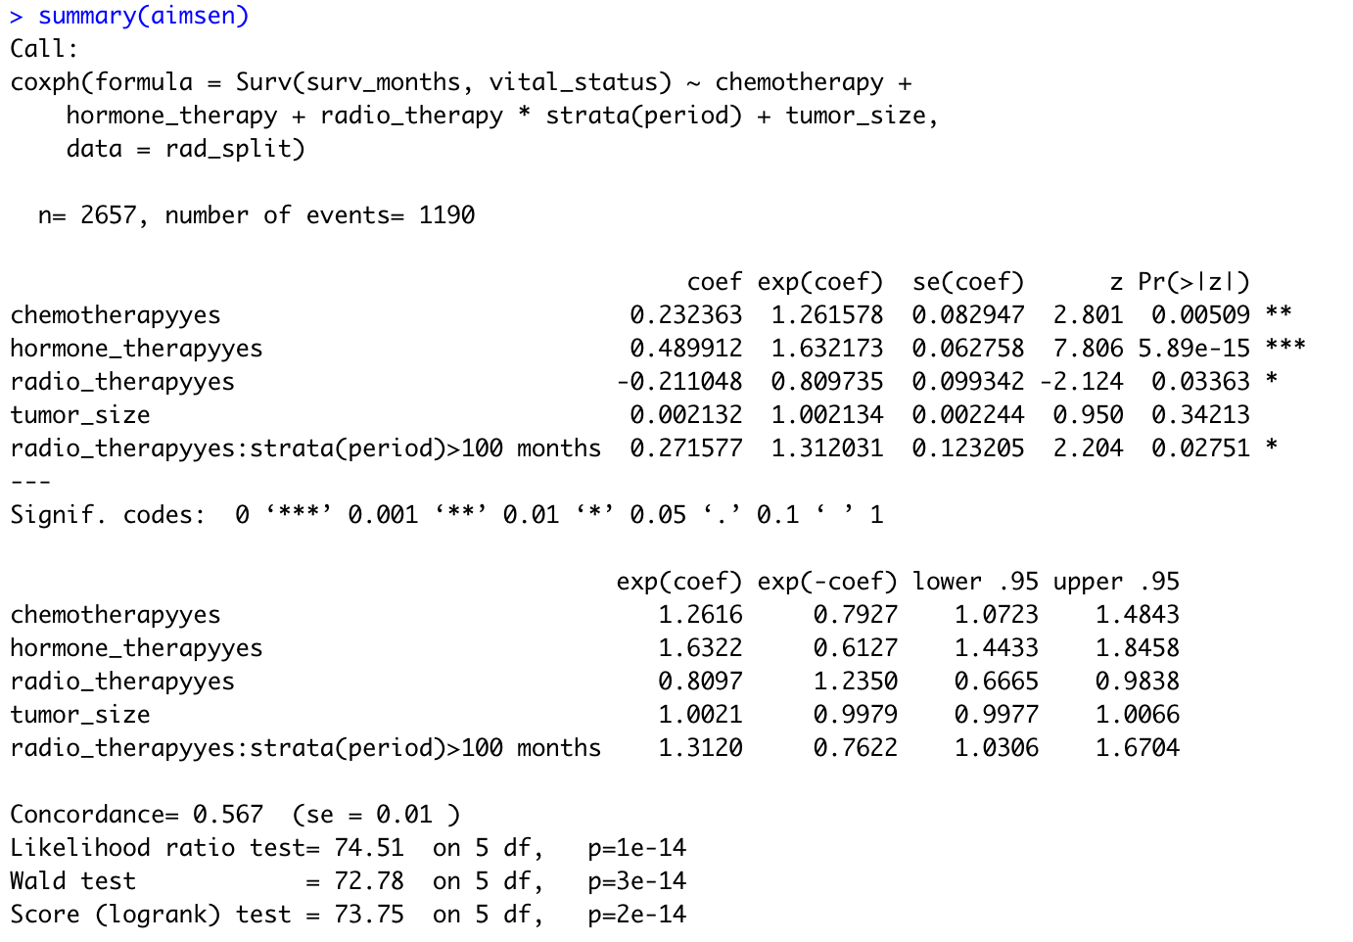
Aim 3 (sensitivity)
aimsen <- coxph(Surv(surv_months, vital_status) ~ chemotherapy + hormone_therapy +
radio_therapy*strata(period) + tumor_size, data = rad_split)
summary(aimsen)

Slide 36
Further Implications
Next generation sequencing is providing new and exciting results.
Large‐scale sequencing data unravels novel somatic and potential targetable mutations as well as allowing the identification of new candidate genes predisposing for familial breast cancer.
High‐throughput analytic approaches, provides for a more individualized treatment course of breast cancer patients.
Combined prognostic markers that include clinical and genetic factors by tumor subtypes.

